Slide 1
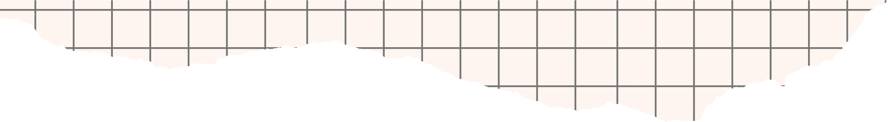

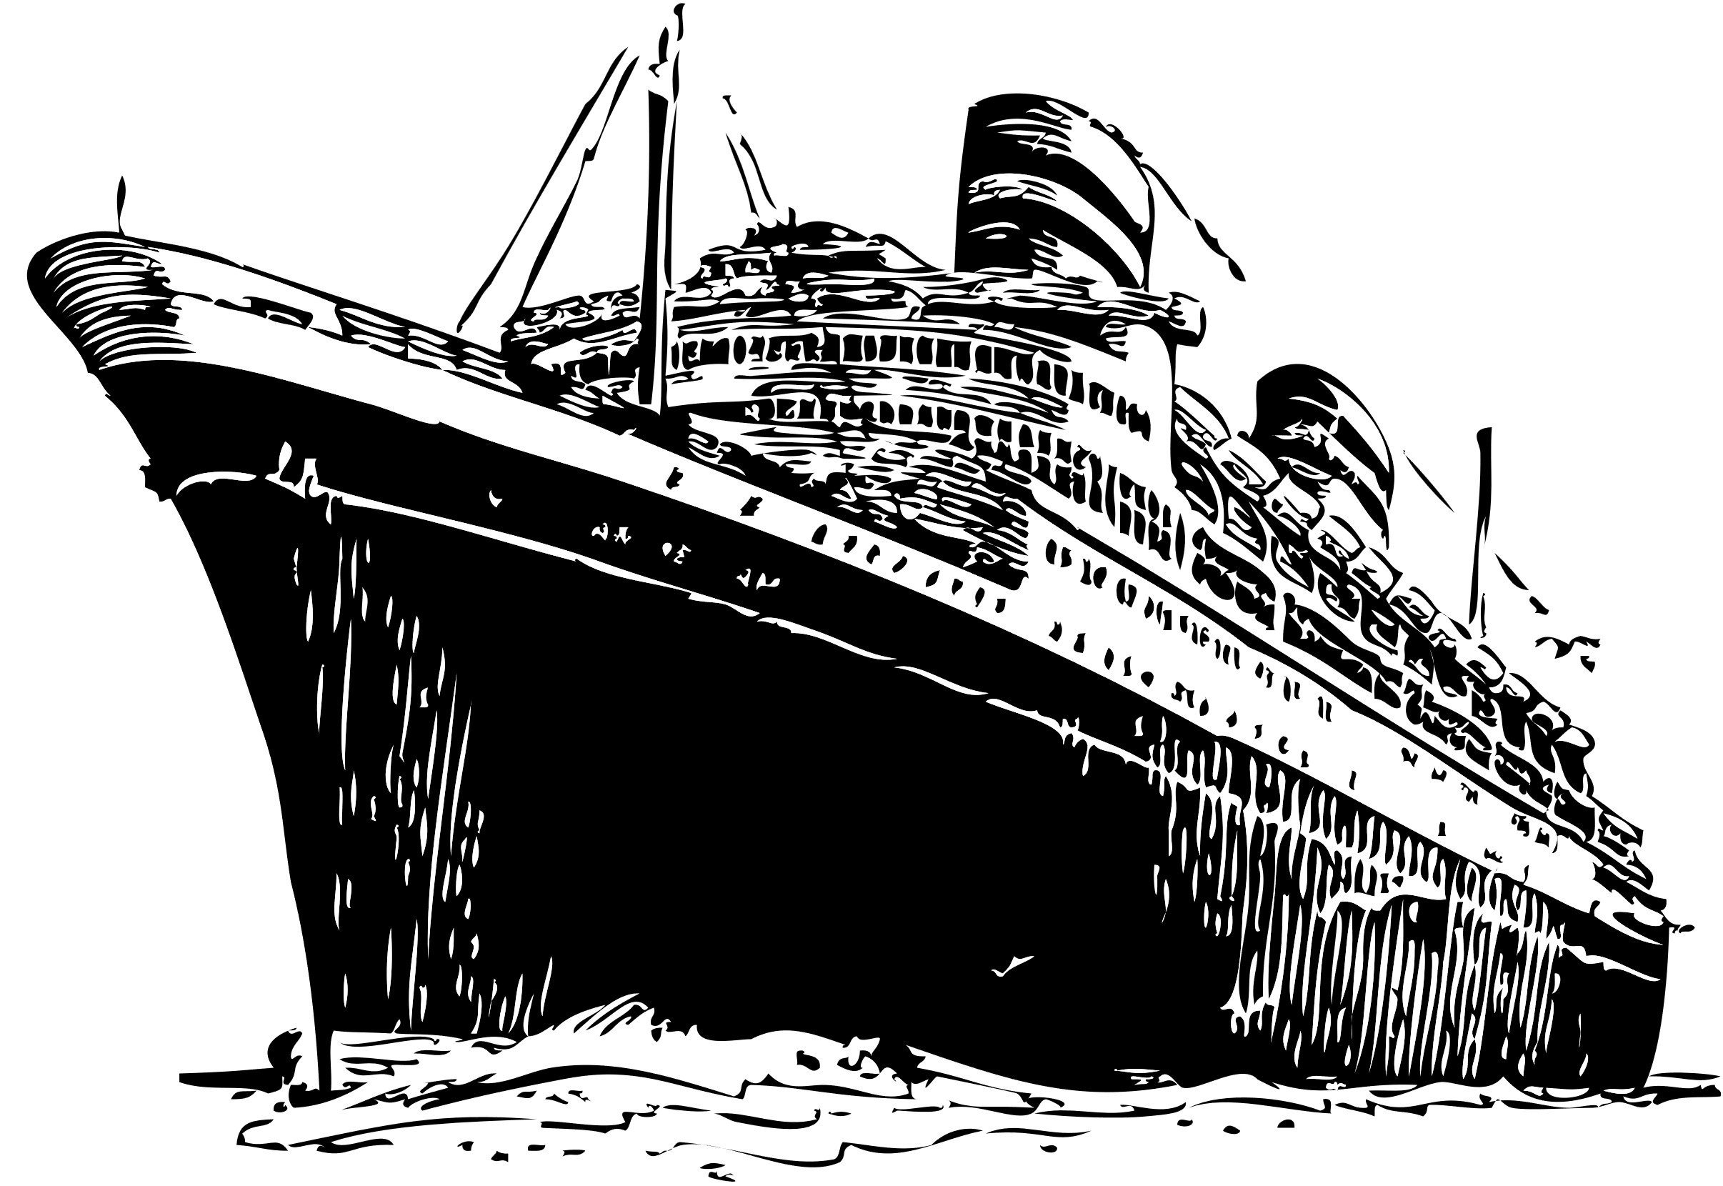

STORY TELLING
THROUGH
TITANIC DATA

Slide 2


AGENDA
EXTRACT ACTIONABLE INSIGHTS FROM DATA
TO UNDERSTAND ASSOCIATIONS BETWEEN DATA
APPLY CLASSIFICATION ALGORITHMS TO CATEGORIZE

Slide 3




ABOUT
891 rows
DATASET
12 columns
Survived
SibSp
Pclass
Parch
Sex
Embarked
Age

Slide 4




INSIGHTS FROM DATA

Slide 5


INSIGHTS FROM DATA
88
31
55.35%
75
7
39%
34%
69
17

Slide 6

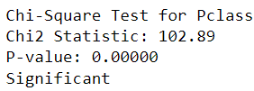
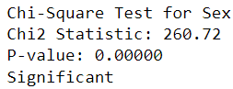
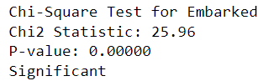
CHI -SQ TEST
Null Hypothesis (H₀): There is no association between Atrributes
Alternative Hypothesis (H₁): There is an association between Atrributes
SEX
PCLASS
EMBARKED

Slide 7

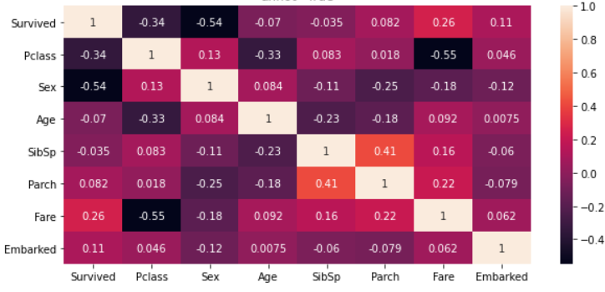
Classification
Apply classification algorithms to classify survival

Slide 8

MODEL
Intercept*4.84 -1.01*Pclass -2.6*sex -0.03*Age -0.28*SibSp -0.08*Parch -0.25*Embarked

Slide 9
ACCURACY SCORE
METRICS
81%
CONFUSION MATRIX
Our classification model has demonstrated excellent performance, achieving high accuracy
[90, 19],
[15, 55]

Slide 10

Results
RESULT 2
RESULT 1
Women had a significantly higher survival rate compared to men
The probability of survival for male passengers increased notably if they were traveling in first class.
RESULT 3
The model identified that male passengers from certain embarkation locations, particularly those from the 'C' (Cherbourg) port, had a higher probability of survival

Slide 11


THANK YOU!

